Slide 1
Biology PGCE University of Leeds
Jenny Lewis

Slide 2
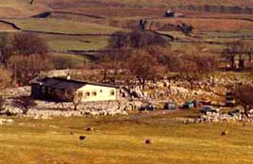
Do it yourself: Selside

Slide 3
5 day residential
Days 1 and 2:
Explore the site, develop the techniques, plan the teaching
Days 3 and 4:
Teach ecology to KS4 students in local school
Explore other habitats and consider their potential/develop own subject knowledge
Day 5:
Recover from the end of course party, clear up and go home

Slide 4
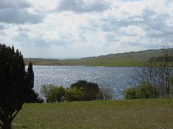
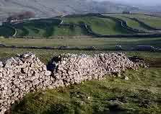
Taking it easy 1: Malham Tarn

Slide 5
Two/three day residential:
Day 1:
Arrive and settle in
Days 2/3:
Assorted activities, mainly to develop subject knowledge and fieldwork skills
(much socialising in the bar)

Slide 6
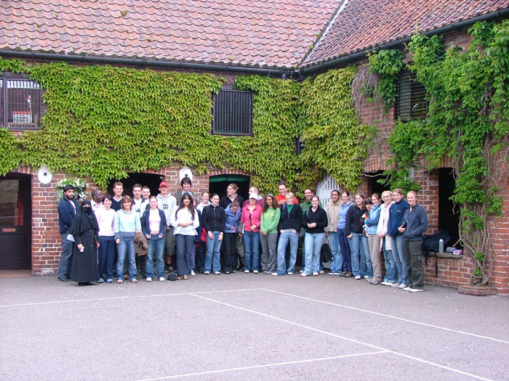
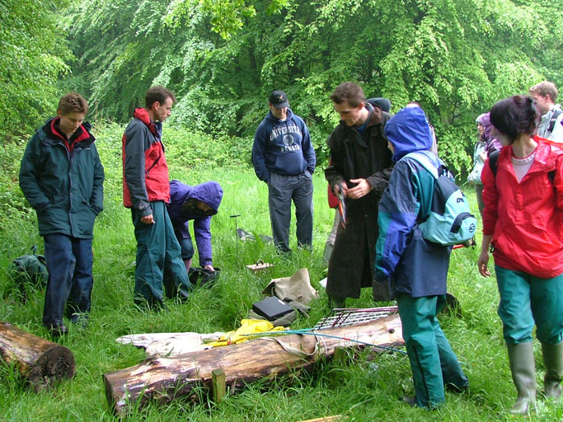
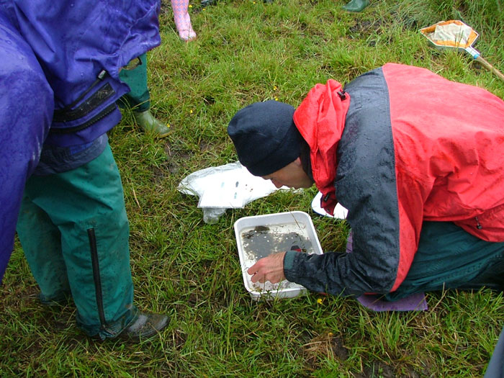
Taking it easy 2: Cranedale

Slide 7
2 day residential
Day 1:as if a school student
Lab based activities as preparation for -
A small investigation to plan and carry out in the field
Wide games
Socialising (definitely not as a school student!)
Day 2: as a teacher
Activities you might use + consideration of where and how
Issues to consider eg management, H&S

Slide 8
Planning a Science Centre Visit
The task
Plan a trip to a science centre which will enhance your students’ understanding of biology, organised to maximise learning and minimise safety issues.
Produce a display in two parts :
i) a poster to inform pupils about the visit and its purpose
ii) an explanation/justification for your chosen approach.
Assess your peers displays against the given criteria

Slide 9
Tropical World

Slide 10
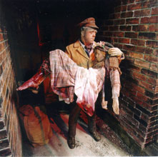
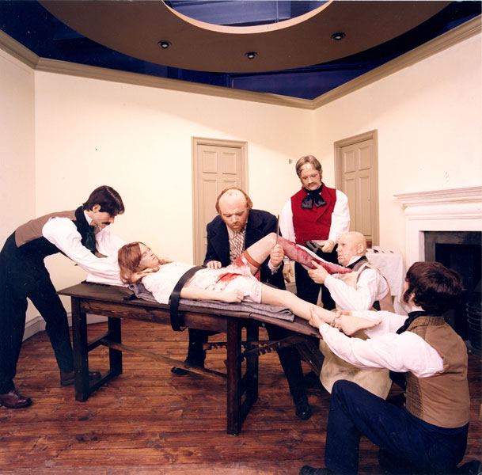
Thackray Museum

Slide 11
The preparatory visit
Identify the materials, displays and resources that are relevant to your chosen topic.
Consider
a) what aspect of your topic might be taught through a visit to the centre and
b) what activities or tasks you could use to do this.
Devise a structured activity that you would use to achieve your purpose. This should include:
Clear learning objectives, linked back to the National Curriculum or exam syllabus.
Instructions for the core activity
Some element of differentiation
An imaginative way of assessing the learning outcomes (think pictures, posters, models, quizzes etc. not just writing).

