Slide 1
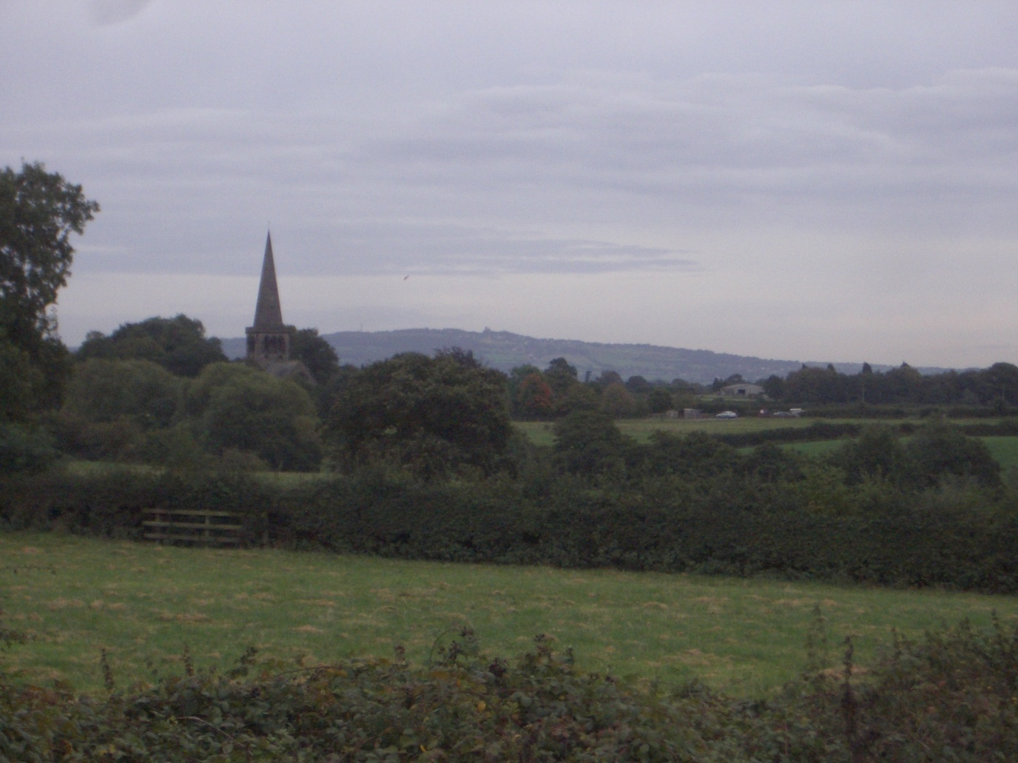
Beyond 2010: STEM beyond the classroom Birmingham Seminar, March 2010 The Keele Science PGCE Outdoor Experience Chris King

Slide 2
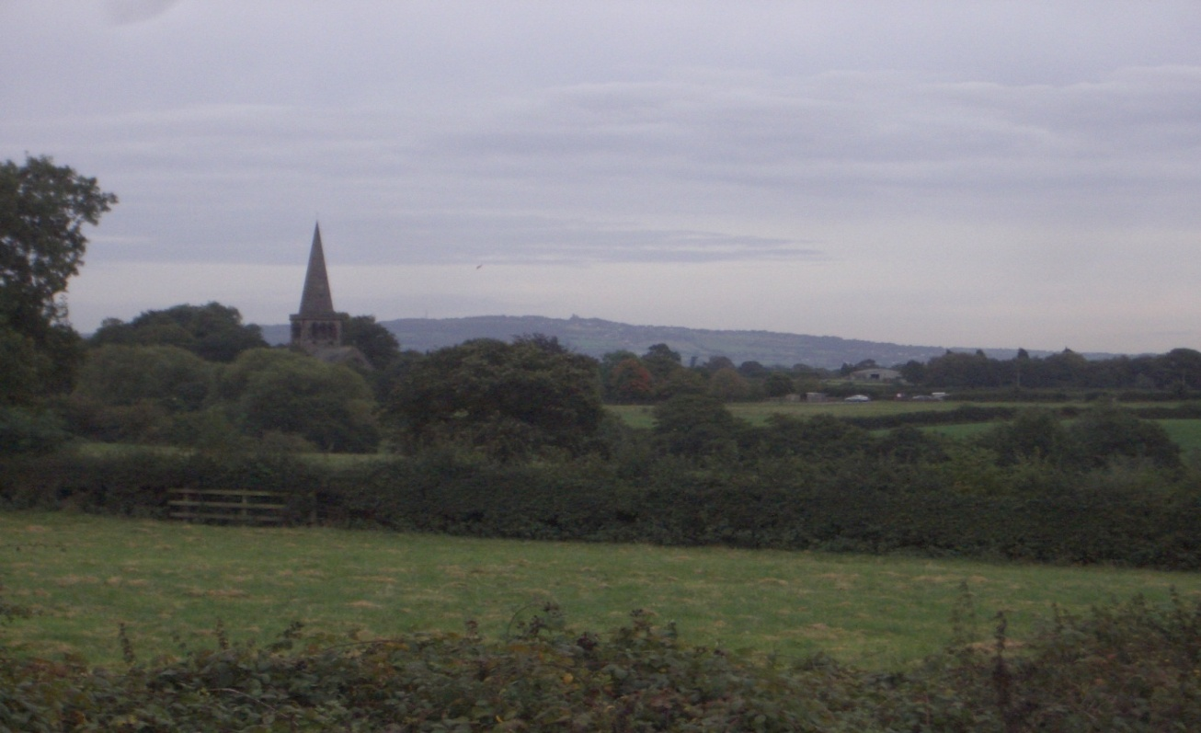
‘Outdoor’ experiences on the Keele Courses
Pre-PGCE Subject Knowledge Enhancement
Two substantive Subject Knowledge Enhancement pre-PGCE courses are run in Chemistry/Physics, a 36 week course (starting September) and a 24 week course (starting January)
Both have a series of examined modules, primarily in Chemistry/Physics but also including additional modules in Chemistry/Physics, Biology
and Earth science (as well as a primary placement)
The 20 hour Earth science module is focussed on a geological cross section through Keele, involving a field visit to key rock formations in the region

Slide 3
‘Outdoor’ experiences on the Keele Courses
The PGCE science/specialism course at Keele
General strategy: from local to regional, from urban to rural
Induction day – science ‘treasure hunt’ around the Keele campus
Late September – residential field visit to Ironbridge Gorge Museum
Early October – two hour ‘Science around your school’ session on the Keele campus
Mid October – as part of their introductory Earth Science session, trainees visit a local graveyard for half an hour
October half term – trainees individually/in groups arrange to visit a Science Centre/Museum and prepare a PowerPoint on its educational potential
February – trainees present their ‘visit’ PowerPoint
Early June – residential visit to the Ecton Hill Field Centre on the margin of the southern Pennines

Slide 4
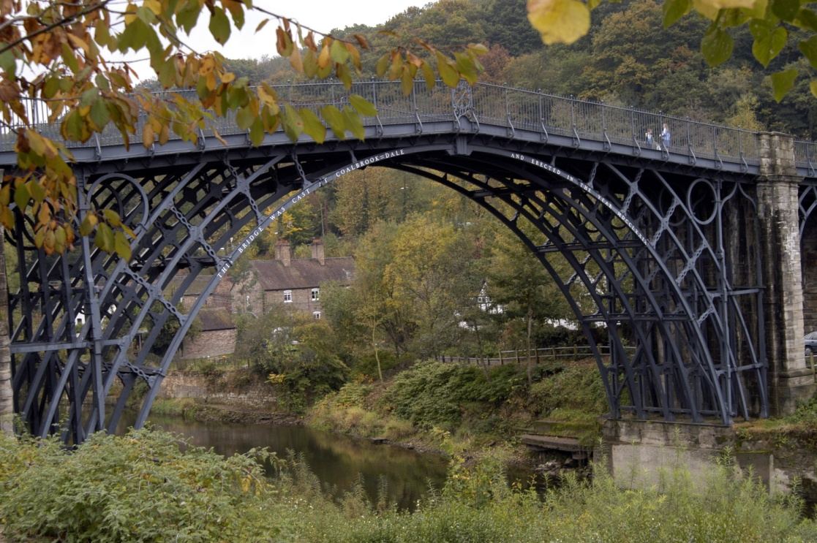
‘Outdoor’ experiences on the Keele Courses
Late September – residential field visit to Ironbridge Gorge Museum
Overnight in one of the Ironbridge Youth Hostels with a team-building activity in the evening
3 hour sessions in a circus including:
Biology – a trail around the Blist’s Hill site
Physics – a range of outdoor physics investigations related to historical activities at Ironbridge
Chemistry – a series of activities at the Enginuity Site – including ‘blast furnace on a splint’
Earth science – a DIY trail around Ironbridge village

Slide 5
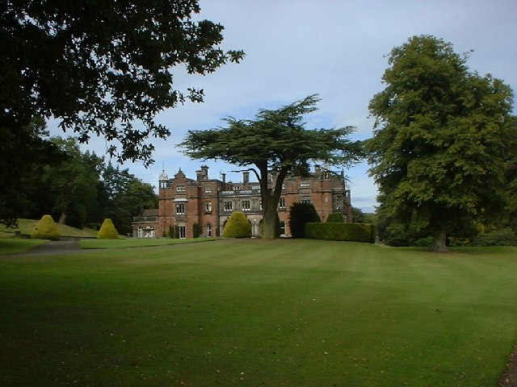
‘Outdoor’ experiences on the Keele Courses
Early October – two hour ‘Science around your school’ session on the Keele campus
Why fieldwork? How fieldwork? What fieldwork?
Environmental evaluation, 1, 2 & 3
Ecological progression, 1 & 2
Stress and strain in the environment
Preserving the evidence – recreating the past
Quarry calculations
Chemical colour conundrum
Stress and strain in the past

Slide 6
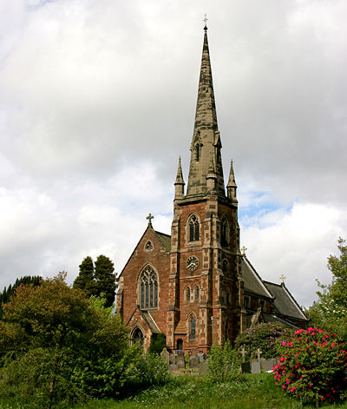
‘Outdoor’ experiences on the Keele Courses
Mid October – as part of their introductory Earth Science session, trainees visit a local graveyard for half an hour
‘Found in the ground’
‘Spot that rock’
Graveyard visit including:
Is there a pattern in rock type distribution?
Which aspects of gravestones weather most quickly?
Are some forms more lichen-covered than others?
Do gravestones weather most quickly under trees or in the open?
How can a a tyre gauge be used to find out how fast marble weathers?

Slide 7
‘Outdoor’ experiences on the Keele Courses
October half term – trainees individually/in groups arrange to visit a Science Centre/Museum and prepare a PowerPoint on its educational potential
Consider:
what the centre/museum has to offer;
cost;
your science education aims and objectives for a school group;
what support is available from the centre/museum;
what activities you would plan;
what pre-visit and post-visit activities you would do in school;
what organisational matters would need to be attended to.

Slide 8
‘Outdoor’ experiences on the Keele Courses
Early June – residential visit to the Ecton Hill Field Centre on the margin of the southern Pennines
Overnight in the Ilam Youth Hostel
A historical copper mine, including ‘black powder’ store, James Watt’s engine house, spoil heaps of minerals, mineral processing remains
Visit into the mine
Make and test black powder; outdoor chemistry to identify elements in minerals; investigations into pulleys and mineral densities; testing the ‘Any quarry guide’; carrying out a river survey, recreating past environments

Slide 9
‘Outdoor’ experiences on the Keele Courses
Some of these Earth science activities are available through the ESEU team from the website at http://www.earthscienceeducation.com

Slide 10
‘Outdoor’ experiences on the Keele Courses
Earth science outdoor workshops available from ESEU
Earth science out of doors – Earth science activities around your school
Will my gravestone last? – a workshop in the local graveyard
‘Any quarry guide’ – use of this guide in a nearby quarry, cutting, cliff or coastal exposure

Slide 11
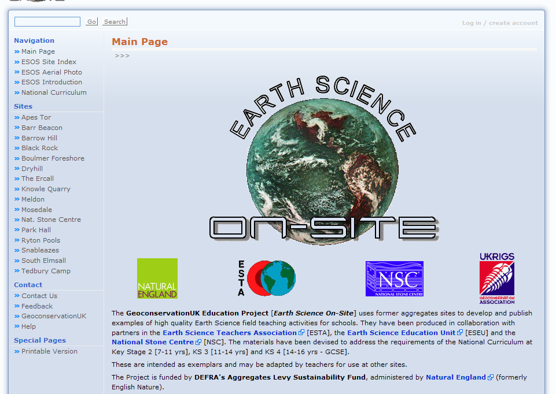
‘Outdoor’ experiences on the Keele Courses
Further Earth science fieldwork activities are available on the Earth Science on Site website, http://www.ukrigs.org.uk/esos/

Slide 12
Beyond 2010: STEM beyond the classroom Birmingham Seminar, March 2010 The Keele Science PGCE Outdoor Experience Chris King

