Slide 1
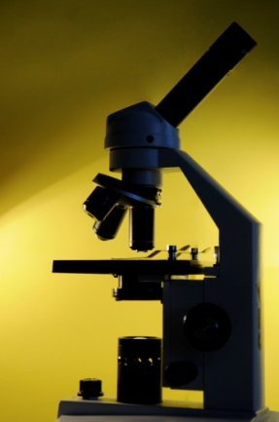
Getting Practical Mapping Strand – reflecting on professional practice
John Wardle, Centre for Science Education, Sheffield Hallam University

Slide 2
Mapping strand
Purpose
Produce a framework to encourage teachers to review and classify practical tasks. Enable:
reflection on learners’ understanding and/or skills
consideration of how practical activity can be presented and staged effectively to delivering particular learning objectives
Outcomes
Produce a tool which will:
support teachers in developing effective pedagogy
use of the tool will be exemplified with case studies of the use of the audit tool in action

Slide 3
Process
CSE, working with Robin Millar, developed a series of reflective tools and tasks to test the categorisation of practical activities.
Teacher reference groups (TRG) used as a test bed for the process, to develop and trial materials and to refine thinking.
Case studies, activities and guidance materials have been produced by working with the TRG schools, fed into CPD.

Slide 4
Mapping
Development of audit tools
process development
work with teacher group
Input to CPD
Section 1 – what is the purpose of practical work?
activities
audits
presentation
guidance
Case studies
KS3/4
KS1/2
materials pack

Slide 5
Mapping the purpose of practical work
discussion activity
audit activity (1)
audit activity (2)
coaching activity
What is the purpose of practical activities?
What makes a practical activity effective?
How can we make a practical activity more effective?
Why do we do practical work?

Slide 6
Reviewing practical activities - and identifying the key learning outcomes
Notes:
Each delegate to fill in one of these sheets for five or six practicals.
Before starting to fill in the sheet, ask them to choose a class they are currently teaching (or have just finished teaching) and note down the last five or six practical activities they did with that class.
It doesn't matter what key stage or level the class is. If this is tricky for delegates, then they should just note the last five or six practicals they did with all classes.

Slide 7
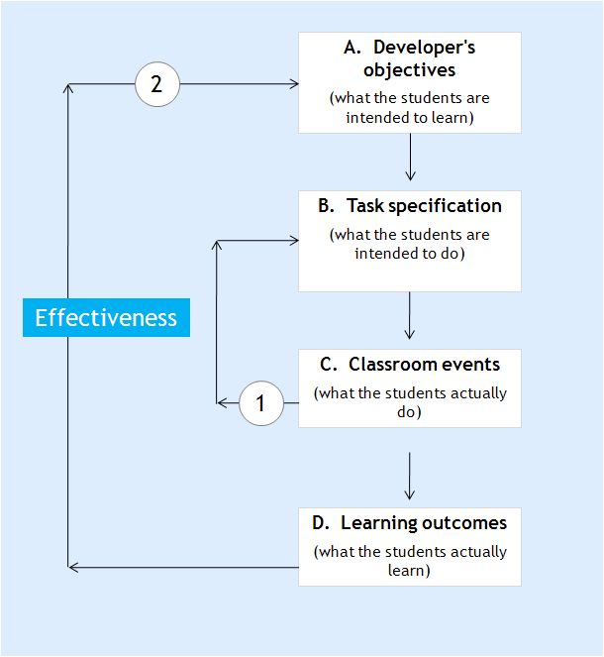
Reflecting on individual activities - to consider their effectiveness
Notes:
The aims of this activity are:
to reflect on whether or not a particular practical achieved what it was intended to achieve
to consider what evidence there is for this
to start to think about how differences in the staging of a practical might help to make it more
Delegates should focus on two practicals they have carried out recently - one which they felt was successful and one which was less so. It might be easier to choose two of the practicals which they also used in the preceding activity, but it doesn't matter.
They should complete one blue sheet for each practical.
As shown on the slide, the blue sheet relates to the flow chart and levels of effectiveness shown earlier, so that delegates being to reflect on the effectiveness of what they are doing, and the evidence they have for this.

Slide 8
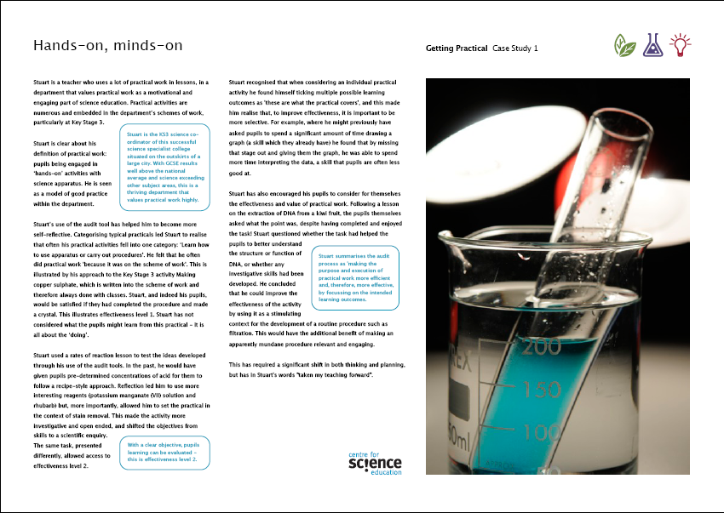
Case studies
introduction
case studies
summary
guidance
The case studies illustrate how the ‘Getting Practical’ approach has addressed issues such as:
departmental approaches and changes
teaching scientific understanding through practical work
developing and supporting NQTS and ITT students
defining the focus of a practical activity
opening up the effectiveness loop – doing to learning

Slide 9
Hands-on, minds-on
Understanding science through practical
Planning for effectiveness
Prioritising the purpose
Doing less, better

Slide 10
Key messages
be clear about the purpose of the practical activity
provide appropriate challenge for students
focus on a limited number of objectives
teach understanding (of concepts) through practical activity
version practical activities for students’ needs
monitor (plan for) coverage and progression of skills, understanding, enquiry by topic/year etc.
not necessary to do more practical, do less better!

Slide 11
Getting Practical Mapping Strand – reflecting on professional practice
John Wardle, Centre for Science Education, Sheffield Hallam University

